Slide 1
Event Management System
Streamlining Event Planning and Execution

Slide 2
The Importance of efficient event management
Why Event Matters
Events brings people together, allowing them to collaborate and celebrate achievements. They’re like special moments that connects us and make us feel a sense of community.

Slide 3
PROBLEM
Lack Of Information
Coordination
Attendee Registration
Attendee Engagement

Slide 4
SOLUTION
To make things better, I’m creating a smart system called the Event Management System. It's like a helpful tool for event planners, making it easy to organize events, keep track of attendees, and share updates in a way that everyone can enjoy the event without any hassles.

Slide 5
Objectives
Streamline event Creation
Timeline and schedule
Event Assigned alert

Slide 6
Proposed System
Event creation with a user-friendly interface, simplifying the input of key details such as date, time, venue, and description.
Attendee registration becomes efficient and convenient, offering a seamless online process that eliminates paperwork and enhances the overall event experience.
The system's visual dashboard provides a centralized hub for organizers to manage events, track registrations, and monitor real-time event metric.
Incorporating modern technologies such as Java for backend development, HTML, CSS, and JavaScript for frontend, and MySQL for database management.
Aligned with a Waterfall methodology, the proposed system focuses on clear requirements, stability, and familiarity with technologies, ensuring a robust and well-structured solution.

Slide 7
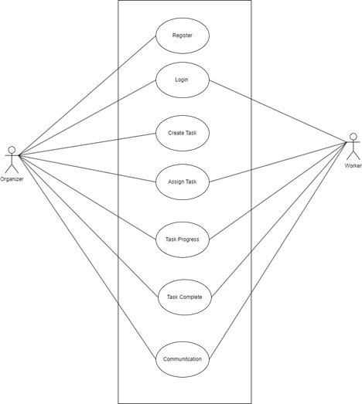
Use case Diagram
Event Organizer: Creates and manages events.
Worker: Assists in event setup and manages on-site logistics.
Direct links show the Event Organizer initiating event-related actions, while the Worker collaborates in setup and logistics within the simplified Event Management System.
By narrowing the actors to the Event Organizer and Worker, the diagram highlights key interactions relevant to event planning and execution.

Slide 8
Conclusion
-Event Management System revolutionizes event planning through streamlined creation, attendee-friendly registration, and real-time communication.
-Fueled by modern technologies (Java, HTML, CSS, JavaScript, MySQL), ensuring reliability and adaptability.
-Aligned with the Waterfall methodology for a structured and efficient development process.
-A commitment to leveraging technology for positive impact, offering a user-friendly, centralized hub for coordination, communication, and management.
-Anticipating a future where events are celebrated effortlessly, our system marks a significant stride towards simplifying and enhancing event experiences.

Slide 9
THANK YOU
Any Question?

